Slide 1
PYTHON timeit MODULE
Buket Yüksel

Slide 2
timeit
The timeit module provides a simple interface for determining the execution time of small bits of Python code.
It uses a platform-specific time function to provide the most accurate time calculation possible.

Slide 3
Usage of timeit
import timeit
timeit()- calling the function 1 million times. (default value)
timeit(1)- calling the function 1 times .

Slide 4
Timer Class
The module timeit contains a class, Timer, which is used to perform the measurement.
timeit.Timer(stmt='pass', setup='pass', timer=<timer function>)
stmt is the statement to be timed and setup is called once before executing the main statement. A timer function can be specified and default is time.time() for all platforms but windows which is set to time.clock().

Slide 5
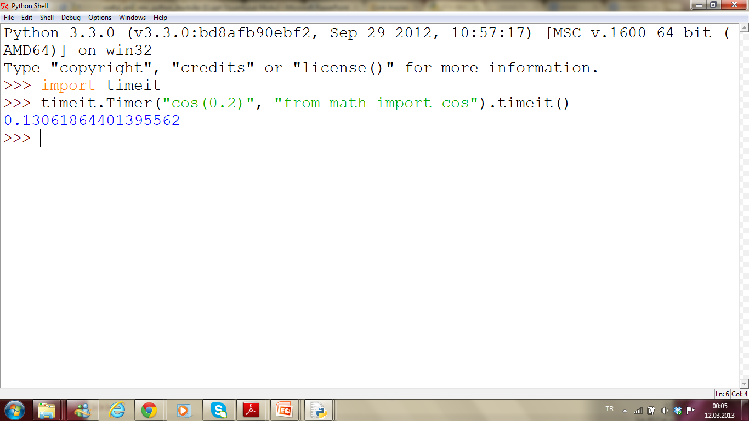
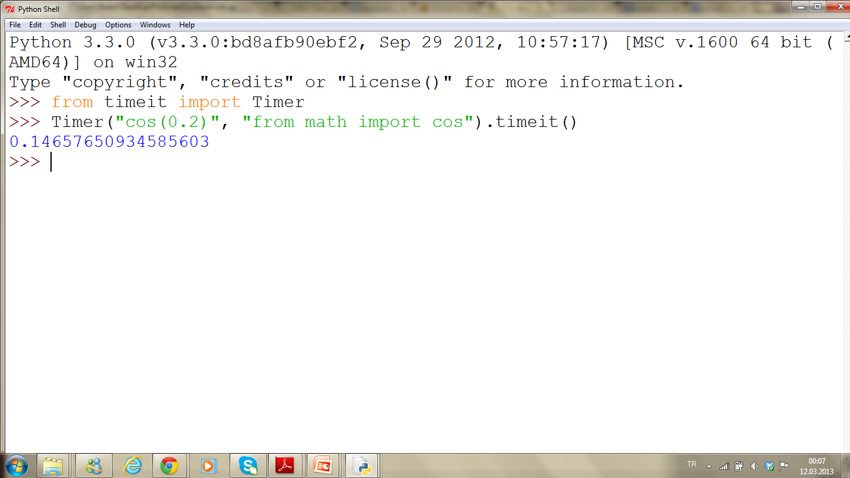

Slide 6
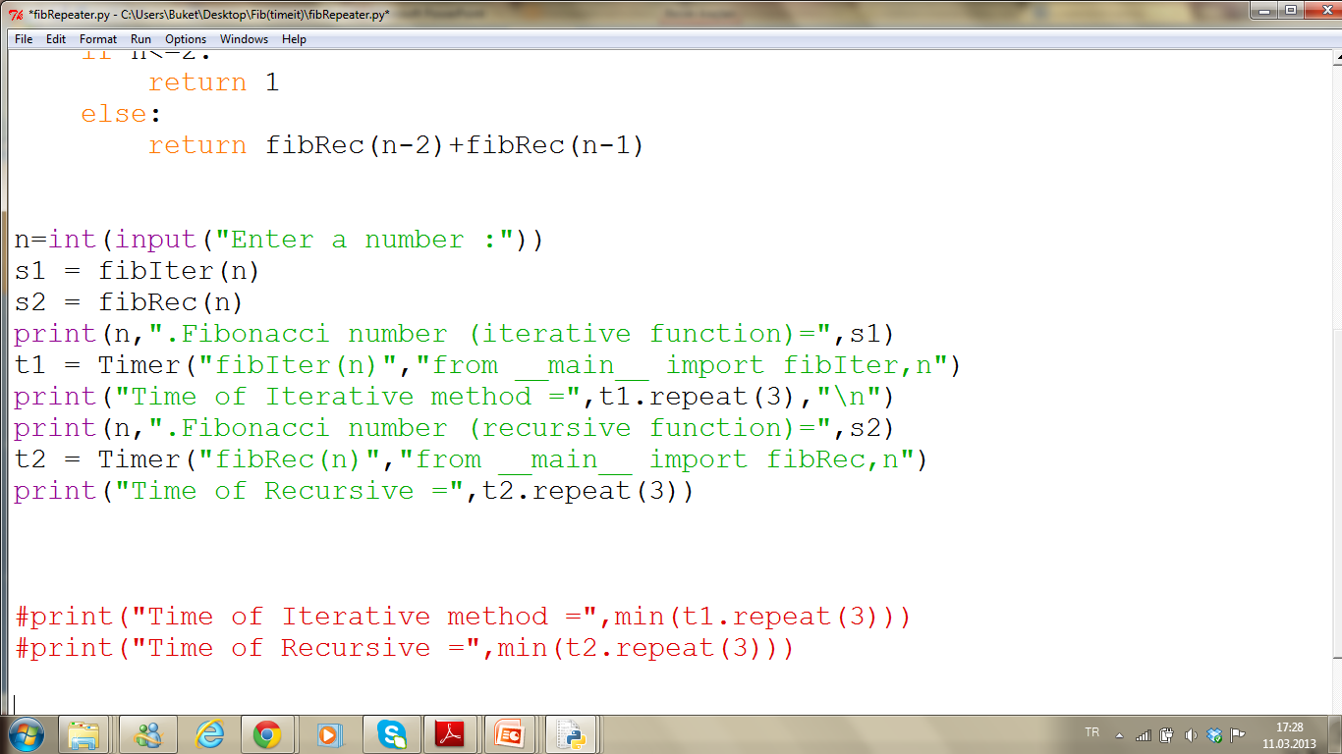
repeat() method

Slide 7
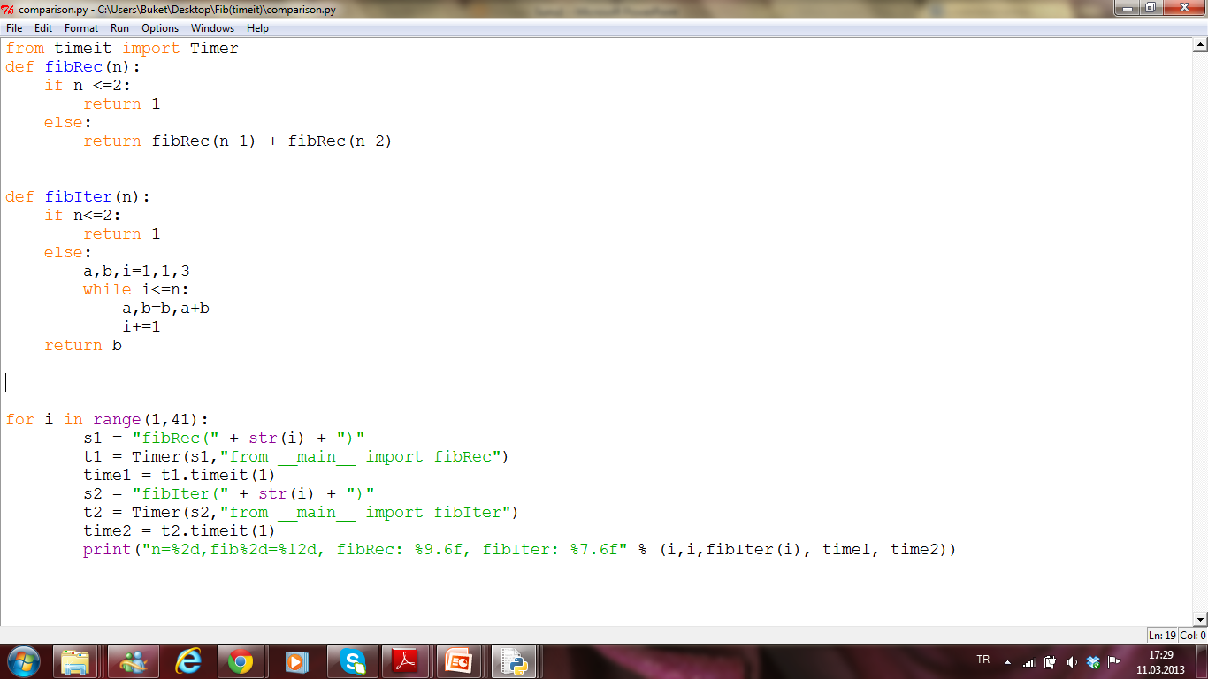

Slide 8
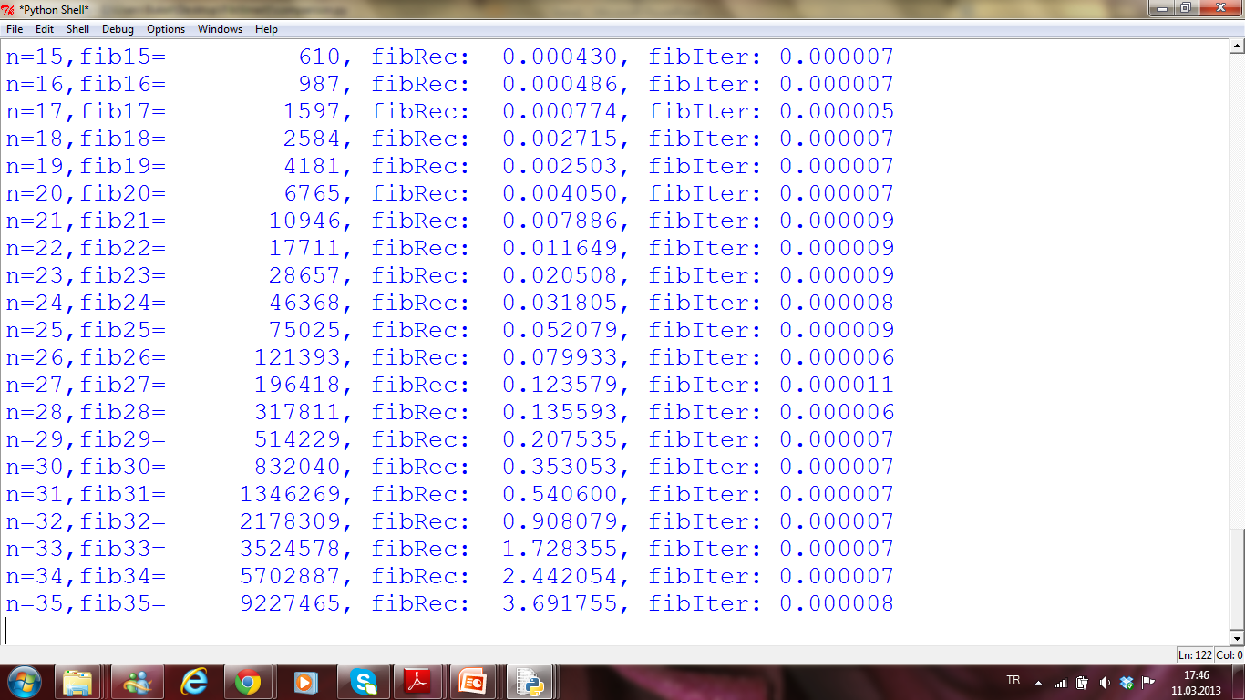

Slide 10
We can implement a "memory" for our recusive version by using a dictionary to save the previously calculated values. - it is even faster than the iterative version.
memo = {0:0, 1:1}
def fibm(n):
if not n in memo:
memo[n] = fibm(n-1) + fibm(n-2)
return memo[n]
For more info about memoization see :
http://www.haskell.org/haskellwiki/Memoization

Slide 11
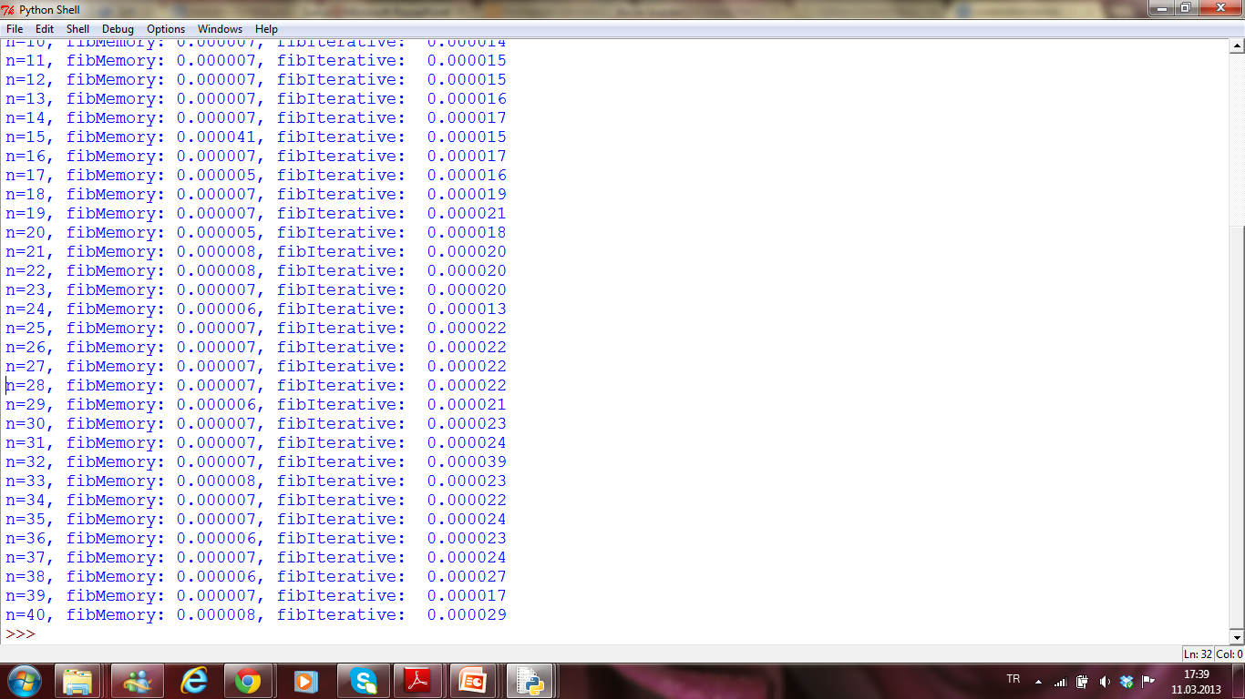

Slide 12
THANK YOU ☺

